Slide 1
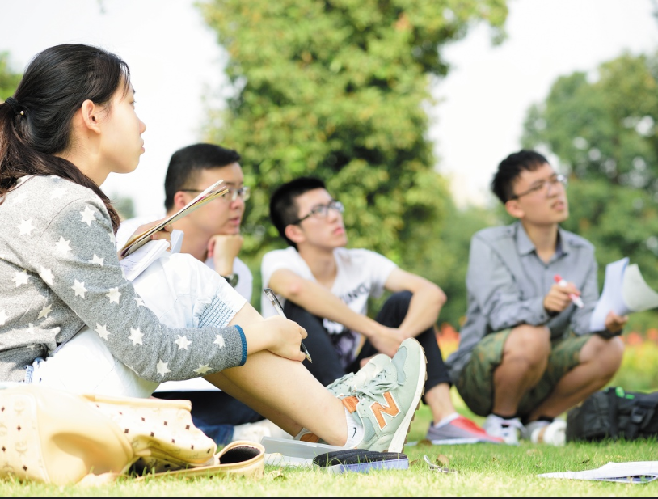

Oral Communication Skills B
(CELEN082)
Lesson 2.2

Slide 2
Lesson aims and objectives
Practise critically evaluating sources for the purpose of deciding whether they are appropriate for use in an academic context. Apply what you have learnt about evaluating sources to the sources that you have found so far for your OCSb presentation.

Slide 3
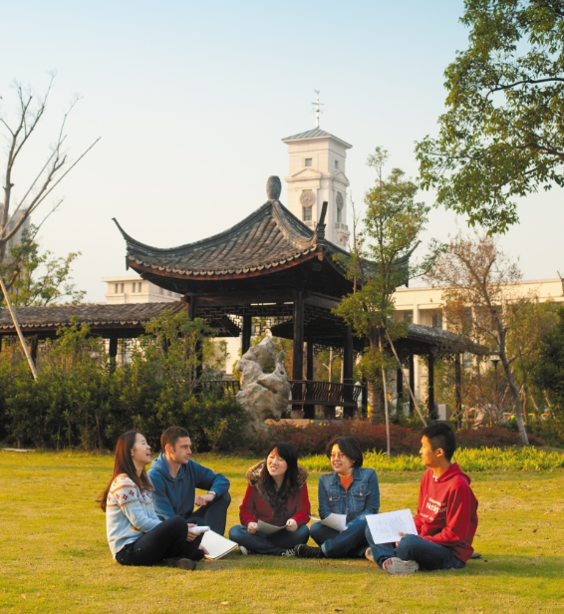
Getting started

Slide 4
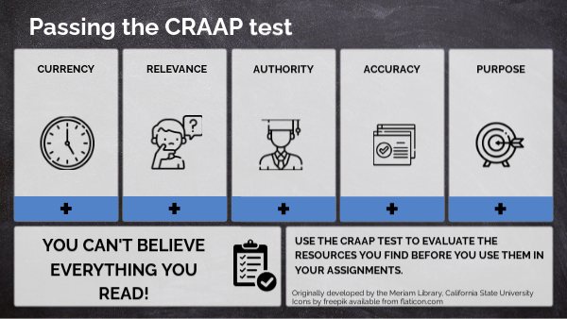
Getting started
The ability to evaluate information and decide whether it is appropriate for use in your university assignments is a key skill in academic study.
For homework, you looked at the CRAAP framework as a way of evaluating sources.
In your group, can you explain what each criterion from the CRAAP framework means?

Slide 5


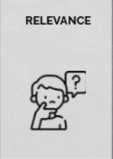

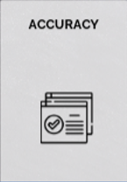

Getting started
This relates to when the source was published. Is the information still current or is it out of date?
This relates to whether the source is useful for your purpose. Does the information help you explain or solve the problem in your Final Presentation?
This relates to the type of source and whether it is reliable or not. Does the author or organisation have expert knowledge?
This relates to the information within a source. Are claims clearly explained and supported with evidence you can check (e.g. citations, hyperlinks)?
This relates to the reason the information exists. Is the author trying to share facts or make a supported argument? Might the author be biased for some reason (e.g. trying to sell something)?

Slide 6
Evaluating the
appropriateness of sources

Slide 7
Source Evaluation
 | Currency | Relevance | Authority | Accuracy | Purpose
Source 1
Source 2
Source 3
Source 4
Source 5
Source 6
Source 7
Evaluate seven sources to decide whether they are appropriate for use in an OCSb presentation on the topic of obesity.
Use the table to help you.
Organise the workload within your group as you wish.

Slide 8
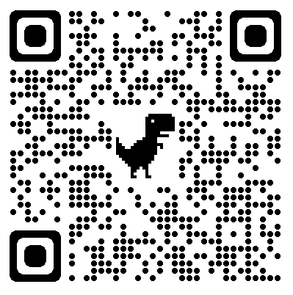
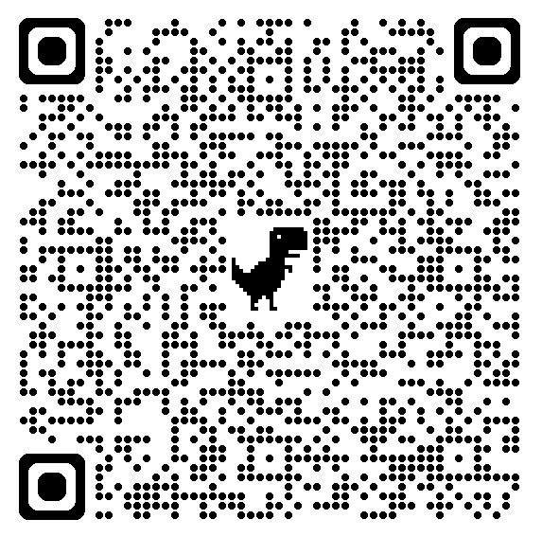
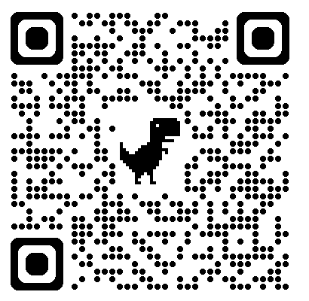
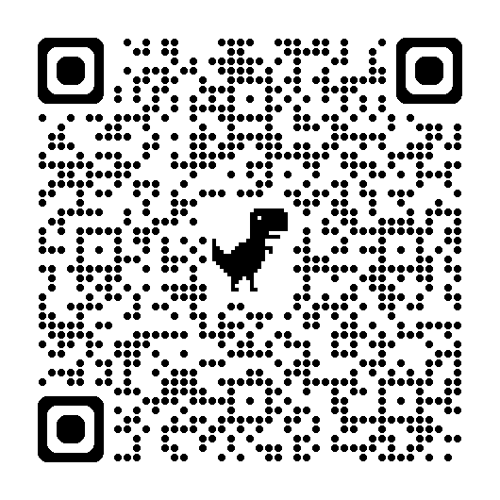
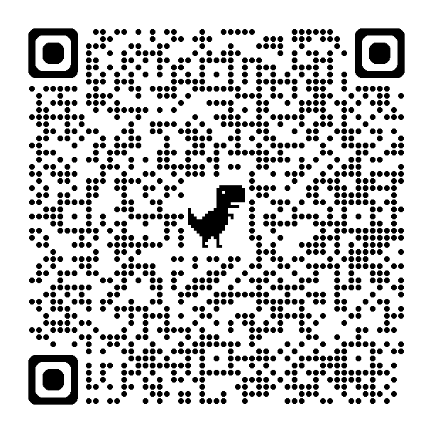
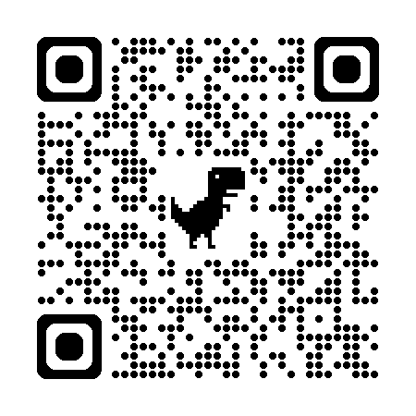
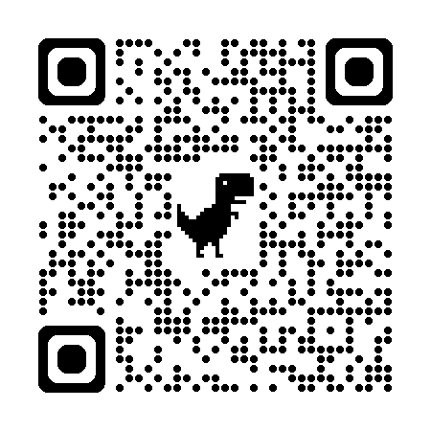
Source Evaluation
SOURCE 1 |  | SOURCE 2 |  | SOURCE 3
Online book |  | Old journal article |  | Recent journal article
SOURCE 4 | SOURCE 5 |  | SOURCE 6 |  | SOURCE 7
Good newspaper | Bad Newspaper |  | Good website |  | Bad website
Notes:
Source 1 (Book): https://nottingham.ebookcentral.proquest.com/patron/WayfShib.aspx?url=https%3a%2f%2fnottingham.ebookcentral.proquest.com%2fpatron%2fAuthentication.aspx%3febcid%3d0802bef77bb448f49d03168a31ddcad1&lid=290&loc=Beta
Source 2 (old journal article):
https://www-jstor-org.ezproxy.nottingham.edu.cn/stable/pdf/41984128.pdf?refreqid=fastly-default%3A3c206ee11d129cd66bccea87b38d9f4a&ab_segments=&initiator=&acceptTC=1
Source 3 (recent article):
https://www.sciencedirect.com/science/article/pii/S1896112624000221?ref=pdf_download&fr=RR-2&rr=9012da386f5ad78f
Source 4 (the Guardian) – original link may not be accessible:
https://www.theguardian.com/environment/2022/may/19/environmental-toxins-are-worsening-obesity-pandemic-say-scientists
Source 5 (the Mirror) – original link may not be accessible:
https://www.mirror.co.uk/news/health/obesity-linked-twice-many-cancers-32783710?utm_source=mynewsassistant.com&utm_medium=referral&utm_campaign=embedded_search_item_desktop
Source 6 (WHO website):
https://www.who.int/news-room/fact-sheets/detail/obesity-and-overweight
Source 7 (personal website):
https://lwrfitness.com/how-to-cut-down-on-sugar/

Slide 9
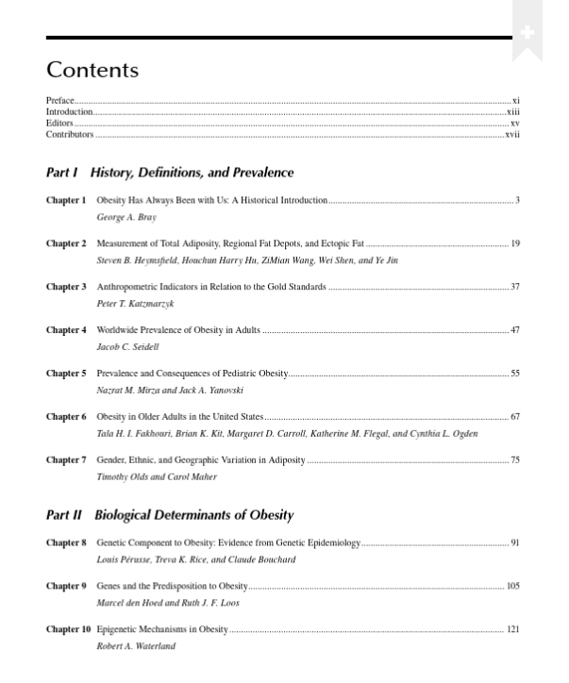
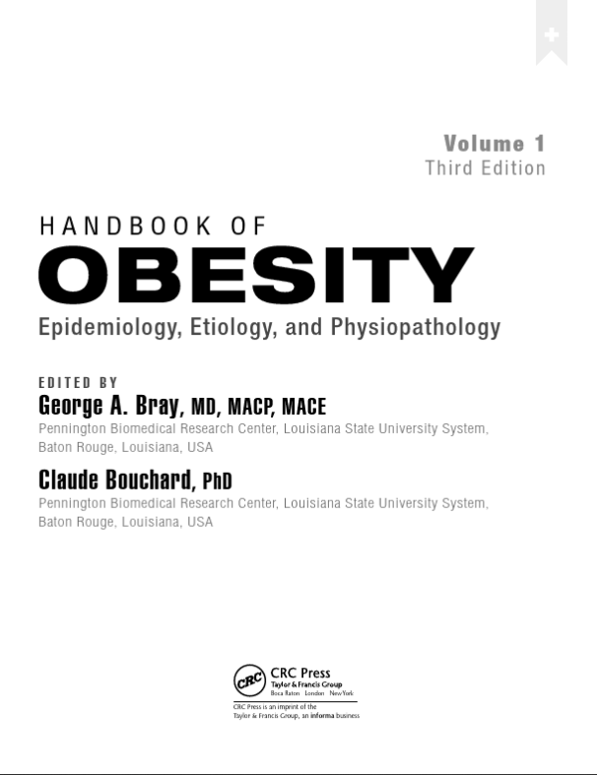
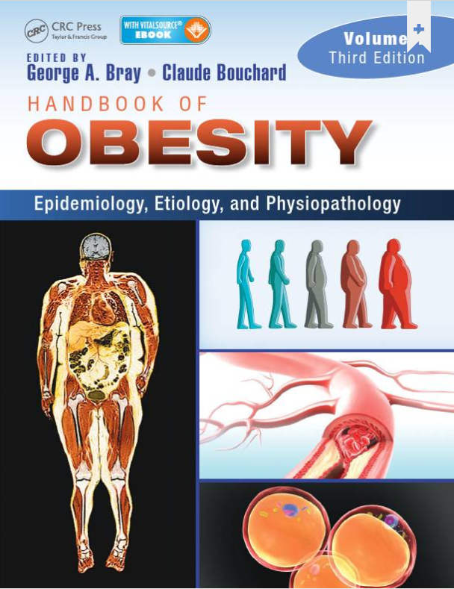
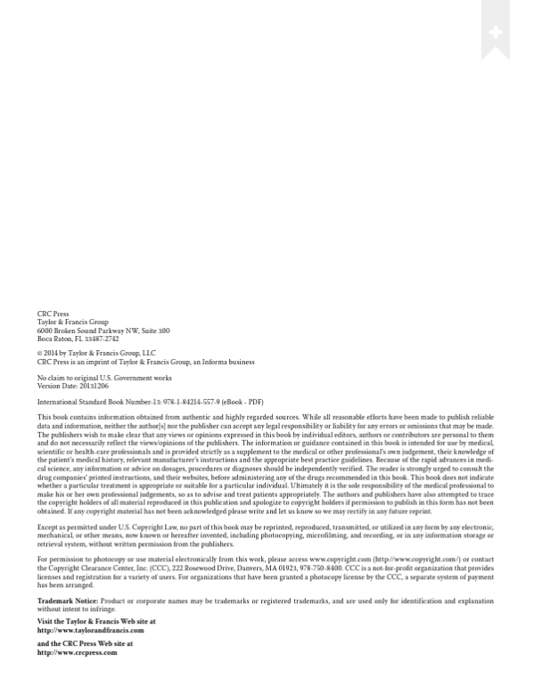
Source 1
Textbook (Edited)
AUTHORITY
A well-known academic publisher
RELEVANCE
Content relevant to ‘obesity’
AUTHORITY
Authors are qualified
CURRENCY
Published in 2014
Still ‘current’ for providing general background information on ‘obesity’
✓

Slide 10
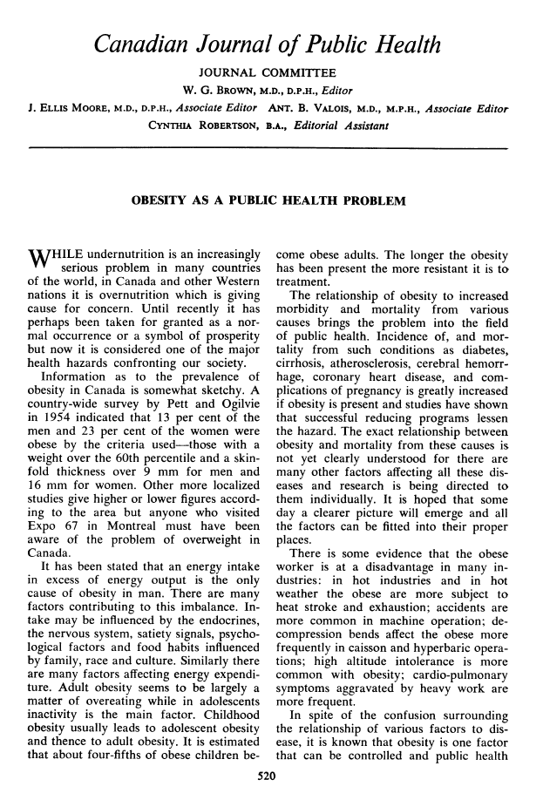
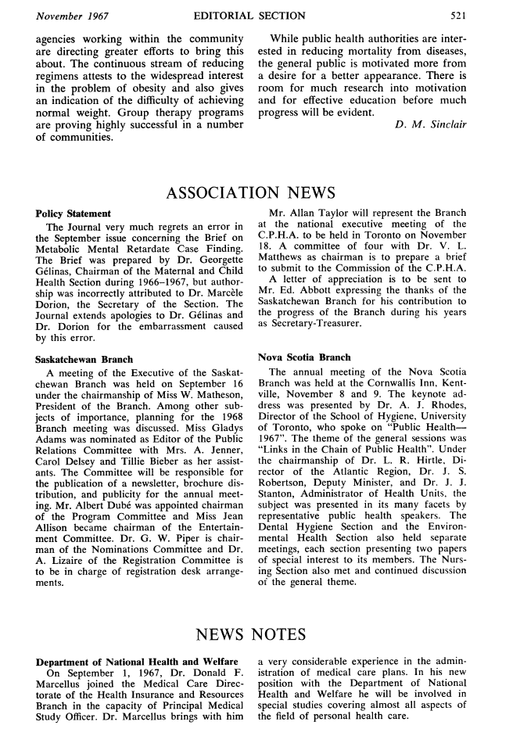
Source 2
Journal article
✗
CURRENCY
Published in 1967.
For the topic of ‘obesity’, a more recent source can most likely be found.
If you choose to use an older source for your Research Poster, you must be able to justify your choice.

Slide 11
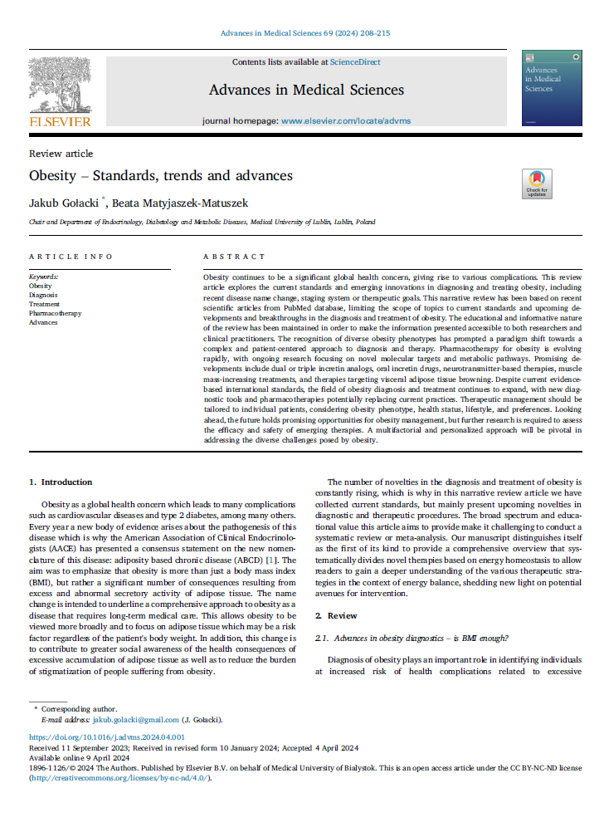
Source 3
Journal article
AUTHORITY
Authors’ workplaces suggest expert knowledge
✓
RELEVANCE
Content relevant to ‘obesity’
In your Research Poster, you must use relevant information from each source to answer research questions.

Slide 12
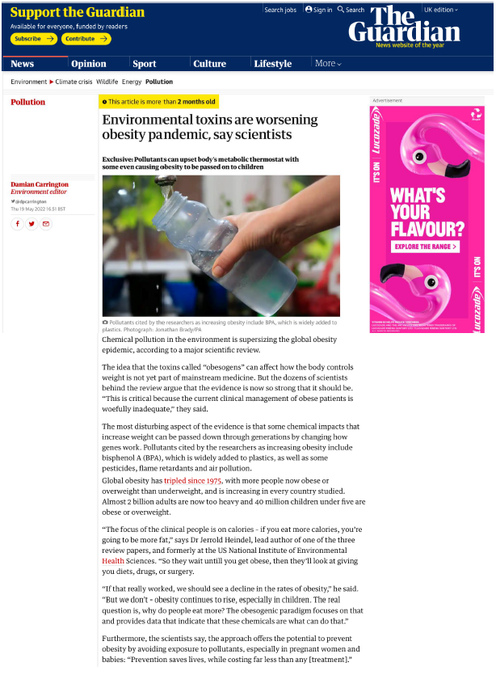
Source 4
Newspaper article
✓
ACCURACY
Having hyperlinks to the original sources means that you can verify the information yourself.

Slide 13
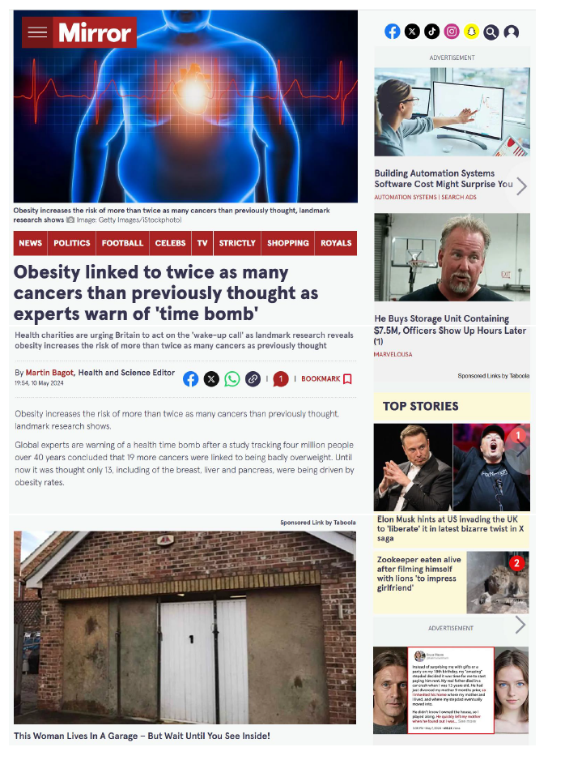
Source 5
Newspaper article
ACCURACY
No references / links to the original sources. You can’t verify the information yourself.
✗
PURPOSE
Celebrity ‘gossip’ articles.
Some newspapers are more reliable than others. Check with your tutor if you are unsure.

Slide 14
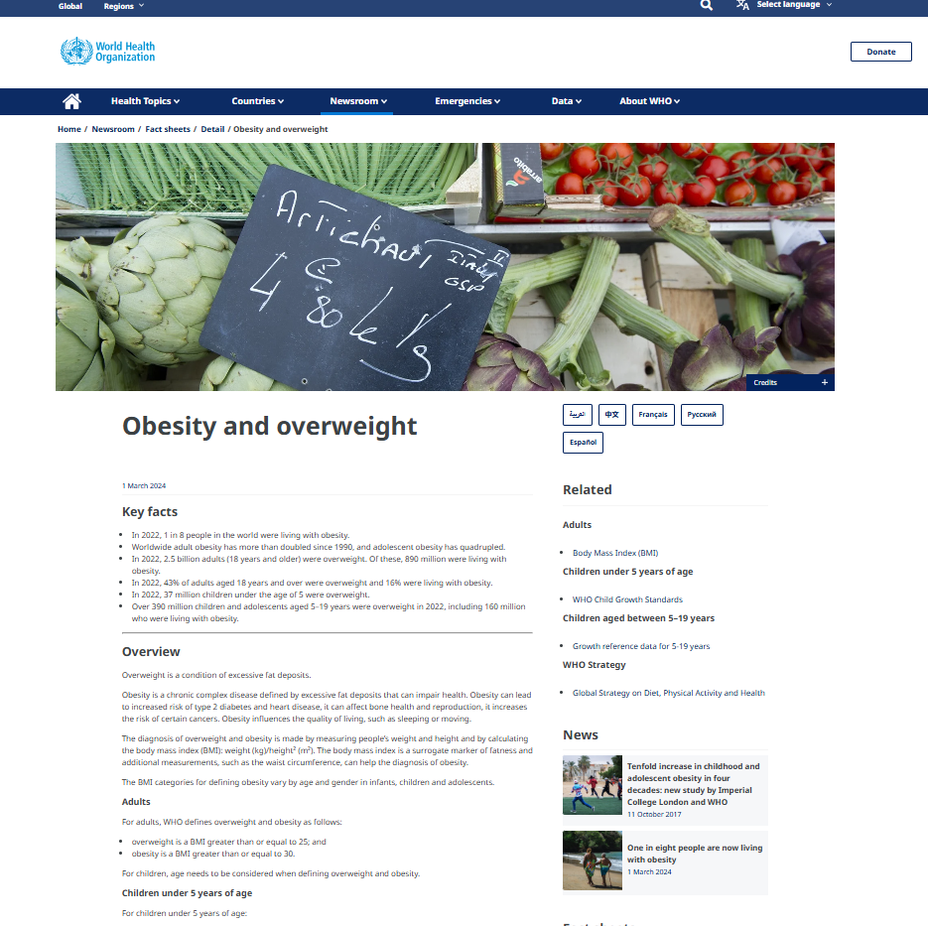
Source 6
Website
AUTHORITY
WHO is a globally recognised organisation and publisher of health-related information.
RELEVANCE
Content relevant to ‘obesity’
✓

Slide 15
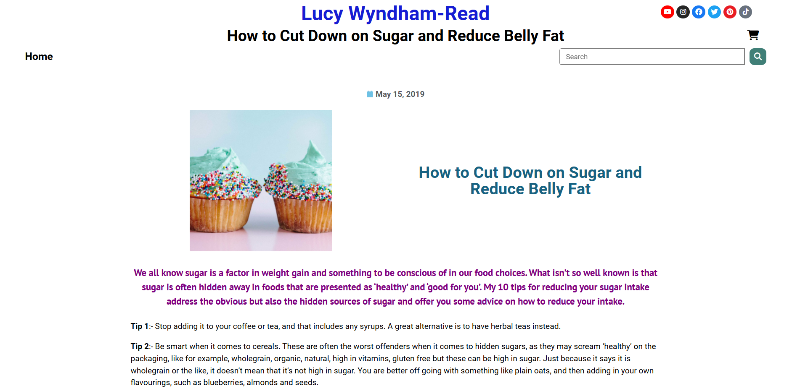
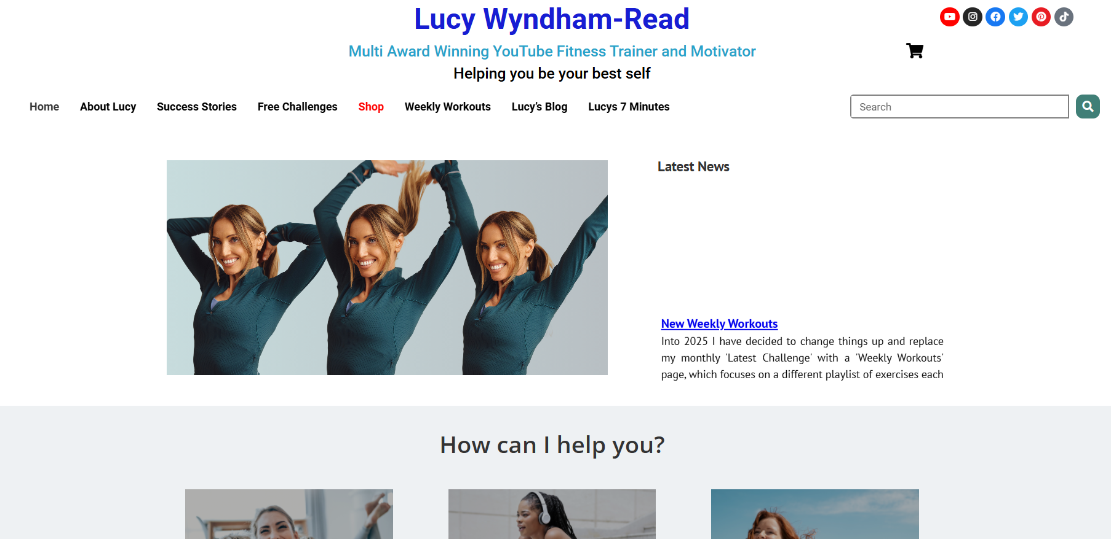
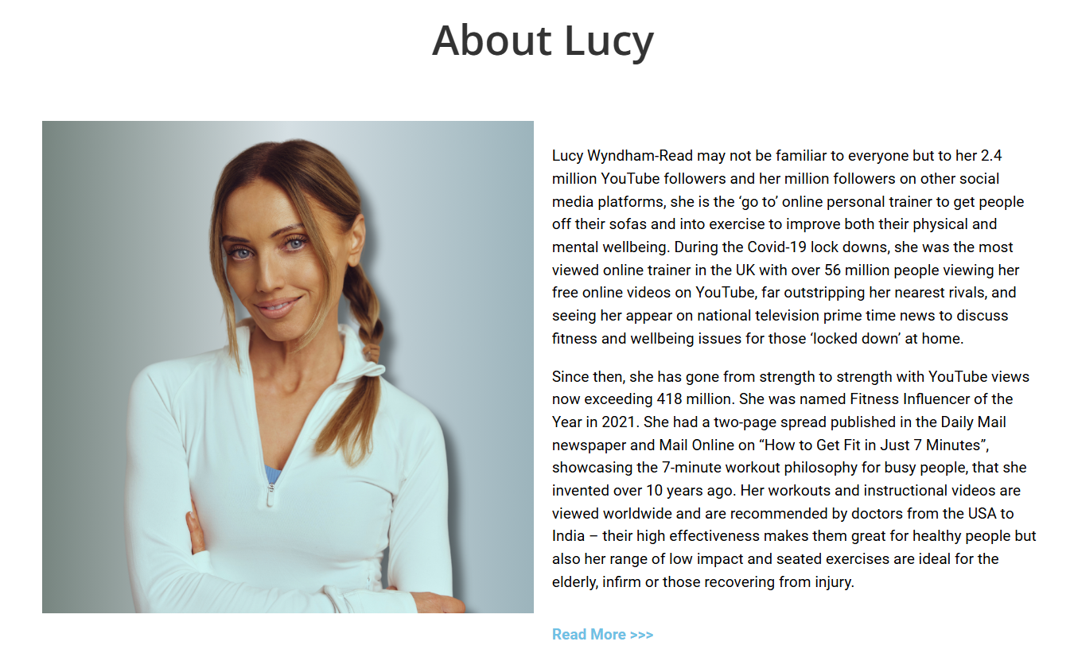
Source 7
Website
PURPOSE
Author is an influencer. Purpose = make money?
AUTHORITY
The author has experience in the health industry, but:
What is that experience?
Does she have qualifications?
✗
In your Research Poster, you must be able to explain how the author is qualified to discuss your topic.

Slide 16
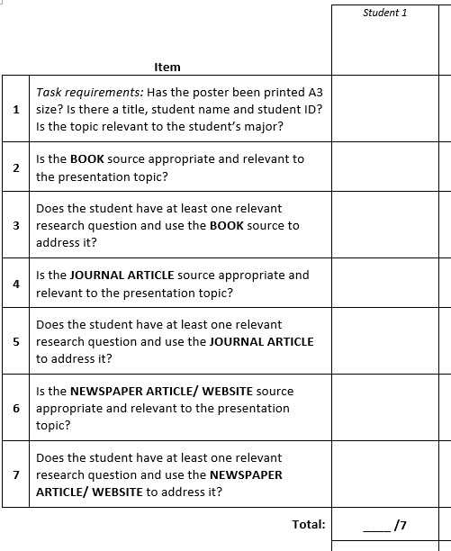
Research Poster: Marking criteria
In the Research Poster, you will be assessed on the appropriateness and relevance of your sources.
Before the Research Poster event, download and read the OCSb 24-25 Research Poster (MARKING FORM) document from the Assessment section on Moodle.

Slide 17
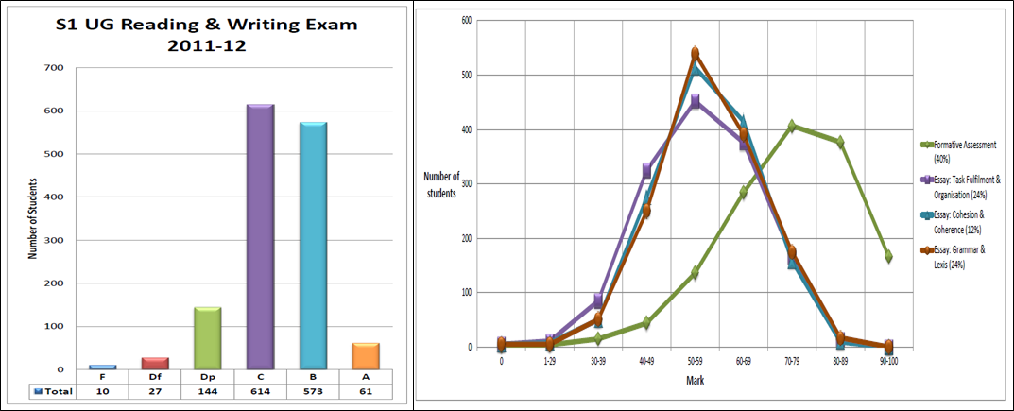
Homework
Due | Task
Before Lesson 3.1 | Find a piece of visual data (e.g. a line graph, a bar chart or a table) that you might want to use in your presentation to explain your chosen problem. Bring it to class and post it on your OCSb group’s Class Team. For example: visual data that shows there is a problem. visual data that shows the negative impacts of the problem.

